Slide 1
FLEPS WORKSHOP Using Technology in the ELT classroom
Besime Erkmen, TEFL Program, METU NCC
berkmen@metu.edu.tr
27.05.2022
EMU, Famagusta

Slide 2
Please, answer the questions.
https://forms.gle/wQv8rbUHqFheSm227

Slide 3
Objectives
Discuss the use of technology in the classroom
Introduce activities/websites that can be used in the writing class
Explore tools for writing activities

Slide 4
What is your definition of technology-enhanced teaching/learning?
Using tablets, computers, smart phones, interactive whiteboards to teach a language.
Computer-assisted language learning (CALL)
Using different technological tools and software to enhance teaching and learning.

Slide 5
1970s 1990s
NOW

Slide 6
Why use technology in the classroom?
It’s authentic
It strengthens the four skills, grammar and vocabulary
It enriches students’ learning experiences
It increases motivation and interest

Slide 7
What should teachers think about when using resources from the Internet?
Learning objectives
Easily accessible
Easy to use
Content
Authenticity
Suitability
Language
Interesting

Slide 8
The Writing Skill
Important to learn the language
To communicate
To practice vocabulary and grammar

Slide 9
Journal
Invitations
Poem
Genre
(Writing)
Blogs
Essay
E-mail
Letter
Dialogue

Slide 10
What is the connection between technology and writing and listening?
Students use technology to put their thoughts into words and/or to have conversations with each other,
They make new friends and establish relationships and
They just have fun

Slide 11
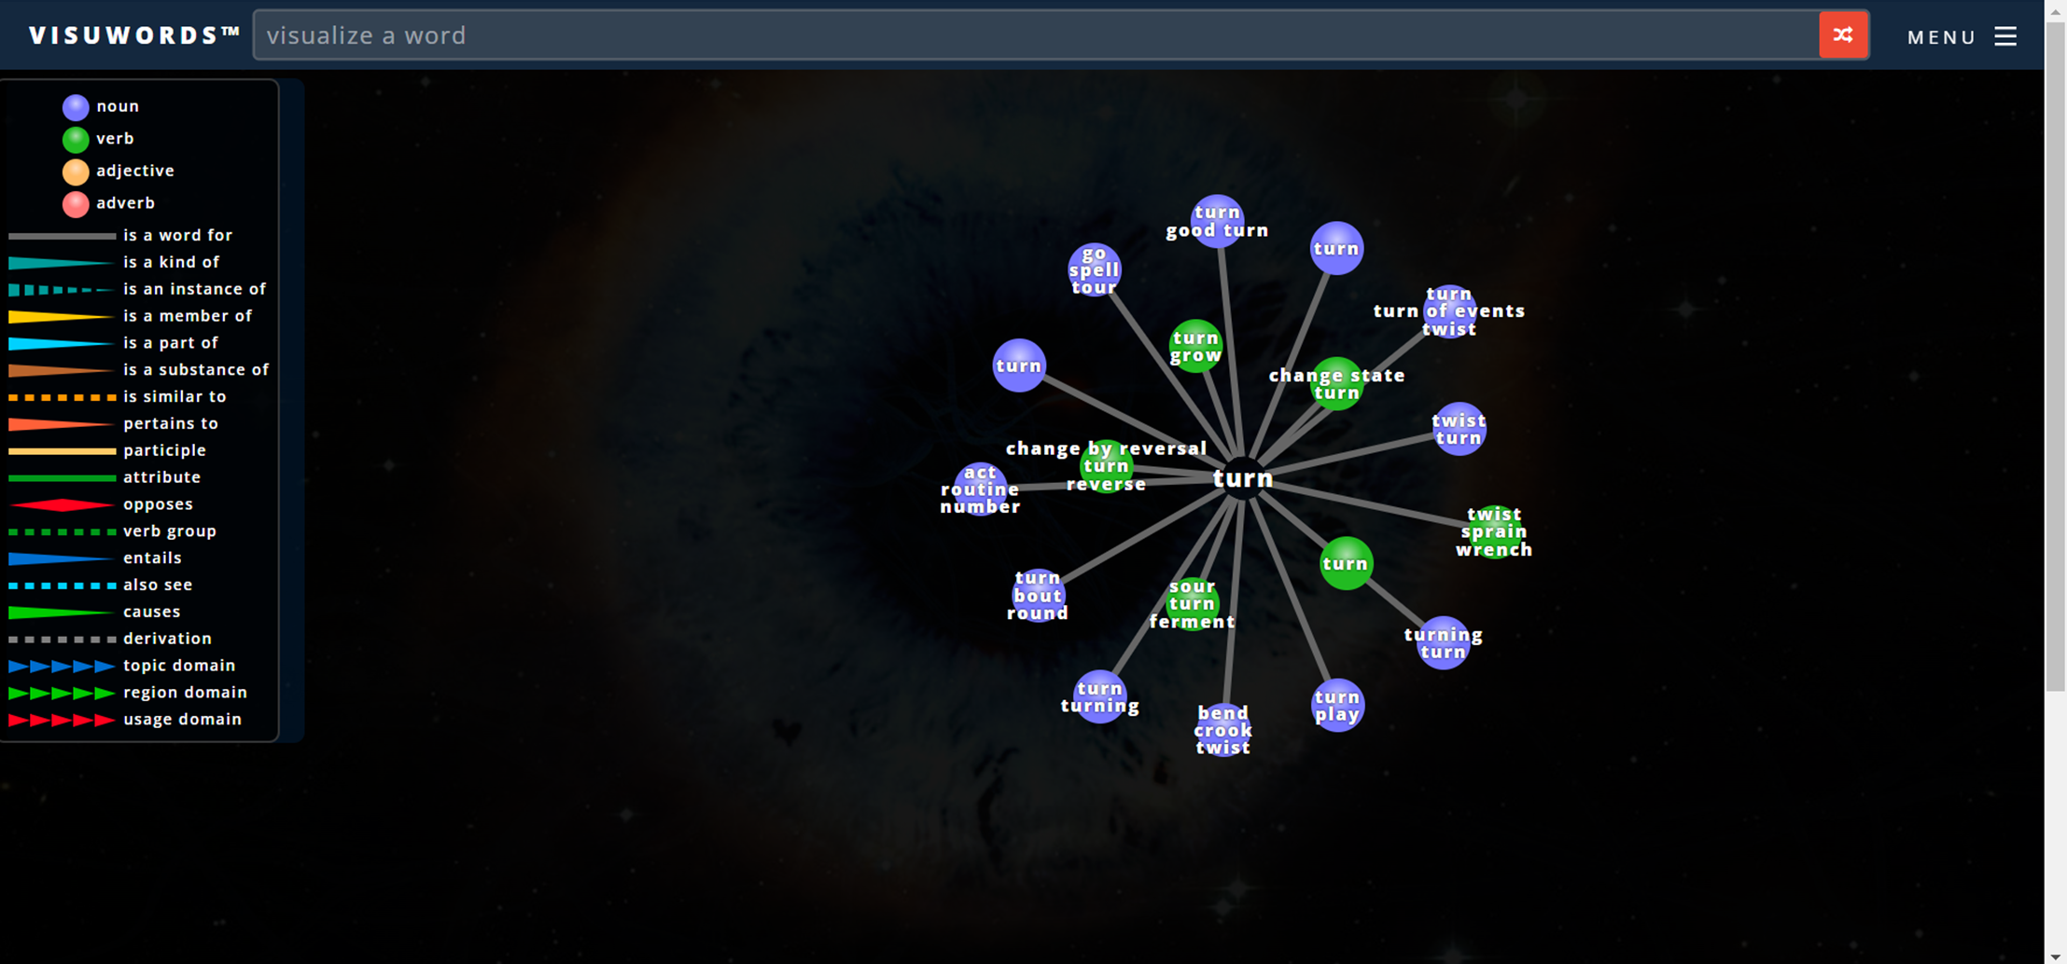
Visuwords: https://visuwords.com/

Slide 12
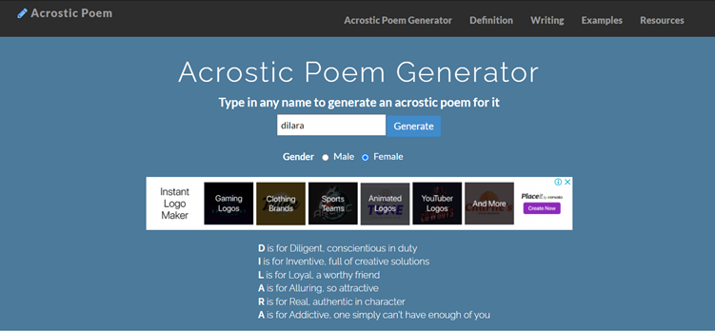
Acrostic Poems
http://www.acrosticpoem.org/
https://magneticpoetry.com/pages/play-online

Slide 13
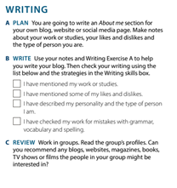

Slide 14
https://www.blogger.com/blog/posts/1092324354431778698?hl=en-GB&tab=jj

Slide 15
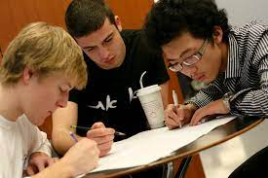
Collaborative writing
Two heads might be better than one or maybe even three might be better than two so that students can benefit from speaking about what they’re writing, getting the ideas of others, and putting all of that together.

Slide 16
Collaborative writing activity
https://drive.google.com/file/d/1w5etF_t8eAZK3x3qukXZiehnGoheMMv5/view?usp=sharing
https://docs.google.com/document/d/1Ih5DROvIF48j-d_qqyUWfE3_BPOf5UbaCj14jrBM070/edit?usp=sharing
https://drive.google.com/file/d/1EiEJ3B2kXJKpqzllpyntwZsafwWTeJNu/view?usp=sharing
https://drive.google.com/file/d/1yScqvF9AubtS_FXTGaSnKn9aZLOchlRn/view?usp=sharing

Slide 17
Who am I?
https://makebeliefscomix.com/Comix/

Slide 18
Solomon R. Guggenheim Museum, New York
https://artsandculture.google.com/partner/solomon-r-guggenheim-museum
https://www.timeout.com/travel/virtual-museum-tours

Slide 19
Pre-writing activities:
Ask them what the visit will be about (either in writing or orally)
Give jumbled words (sentences) about the museum and have them put them in the correct order.
While-writing activities:
Give directions to students. Ask them to locate the painting.
Set up different locations for different groups and then come together to discuss what they saw.
Ask them to write about two paintings. (What they liked or disliked?
Post-writing activities:
Quiz about the museum.
Ask them to write a review, summary or a blog.
Notes:
Directions: Go straight

Slide 20
Using videos in the classroom (writing and listening skills)
Before watching:
www.mindmeister.com
www.miro.com
While watching
After watching

Slide 21
Marriages
https://padlet.com/berkmen1/16jbtlaacvyzox1h

Slide 23
Pre-listening
Aim: To generate interest, introduce vocabulary, activate knowledge about the topic, make predictions using the visuals.
Materials: Pictures in the video.
Instructions:
Divide students into groups of 4.
Ask students to come up with as many words as possible.
Elicit answers.
Tell them that the pictures are from a video and ask them what the topic of the video might be about. (you may write the topics on the board)
Watch the video and let students check their predictions about the topic.

Slide 24
3.
4.

Slide 26
While-listening
Aim: To practice note-taking skills while watching the video.
Materials: A fill-in-blanks activity and comprehension questions.
Instructions:
Give a comprehension check activity.
Ask them to complete the activity individually.
Ask them to compare their answers with their pairs.
Elicit the answers and watch the video again (if necessary).

Slide 27
2. Dubbing
https://www.wingclips.com/movie-clips/the-break-up/leaving-the-argument
https://www.youtube.com/watch?v=_bqhVqTuFO4
What’s going to happen next?
3. Arranging the pictures and/or texts in the correct order

Slide 28
Websites for mind maps
www.mindmeister.com
www.miro.com
Online diary:
www.padlet.com
www.penzu.com

Slide 29
Post-listening
Aims: To expand the knowledge about the topic, think critically and express opinions.
Materials: Questions for discussion.
Instructions:
Ask students to work in small groups.
Ask each group to share their discussion results.
Activity:
What was the most interesting thing in the video?
How are couples in your culture?

Slide 30
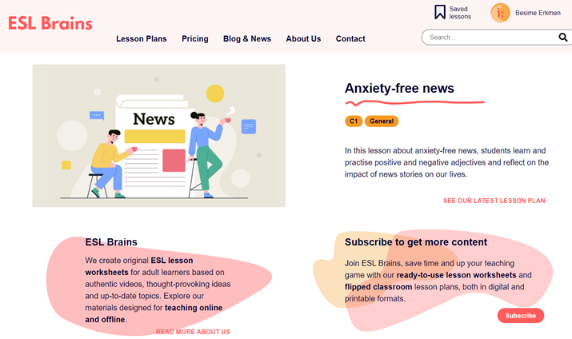
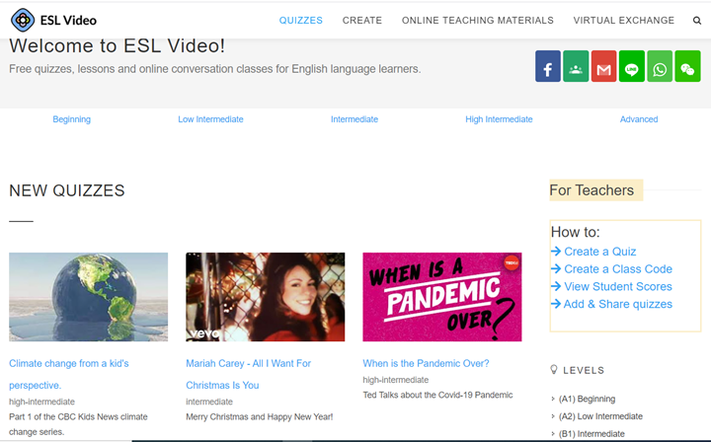
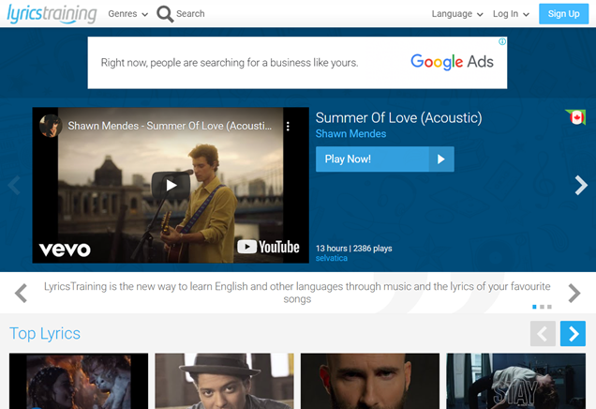
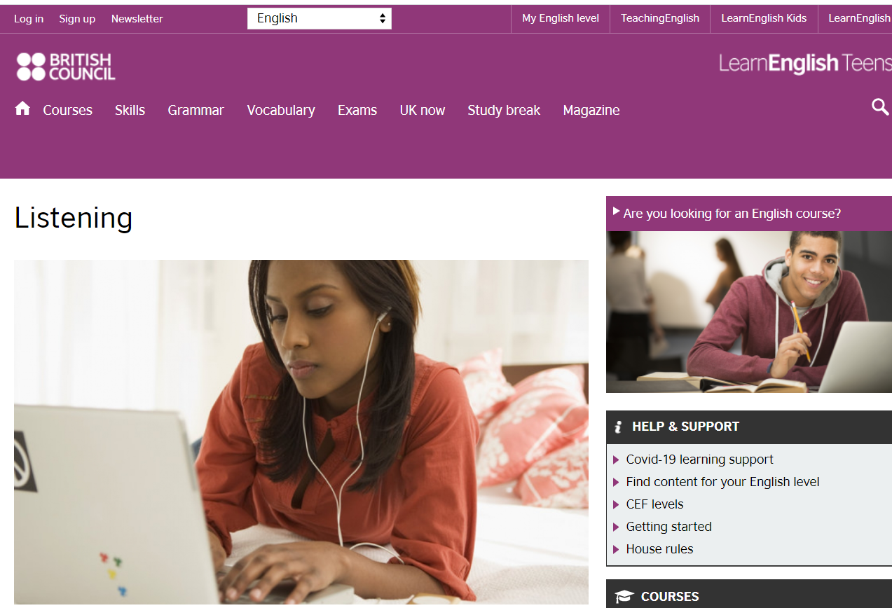
www.animaker.com
https://learnenglishteens.britishcouncil.org/skills/listening
https://eslvideo.com/
https://eslbrains.com/
https://lyricstraining.com/
https://www.elllo.org/index.htm

Slide 31
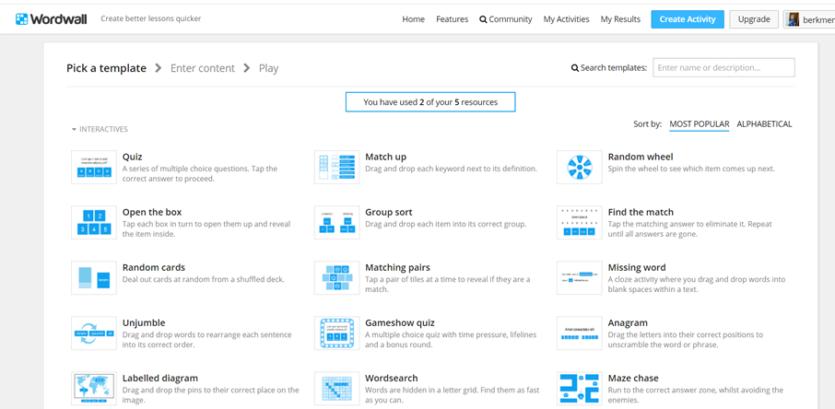
Websites to practice grammar
Wordwall.net
https://learningenglish.voanews.com/p/5610.html
https://learnenglishteens.britishcouncil.org/grammar
https://www.playgrammarninja.com/
http://www.roadtogrammar.com/
https://grammaropolis.com/
kahoot

Slide 32
https://forms.gle/PEpZ7BjA8pMUz8aq7

