Slide 1
How to Make Stress Our Friend
Özlem Burak (MSc) Senior Instructor & Specialist Psychologist
Eastern Mediterranean University
Mayıs Psikoloji, Nicosia

Slide 2
After catastrophic events such as earthquakes and pandemics, it is very normal to feel anxiety, stress, and exhaustion temporarily.
However, chronic stress is NOT healthy.
Now, it is time for RECOVERY and RECREATION.

Slide 3
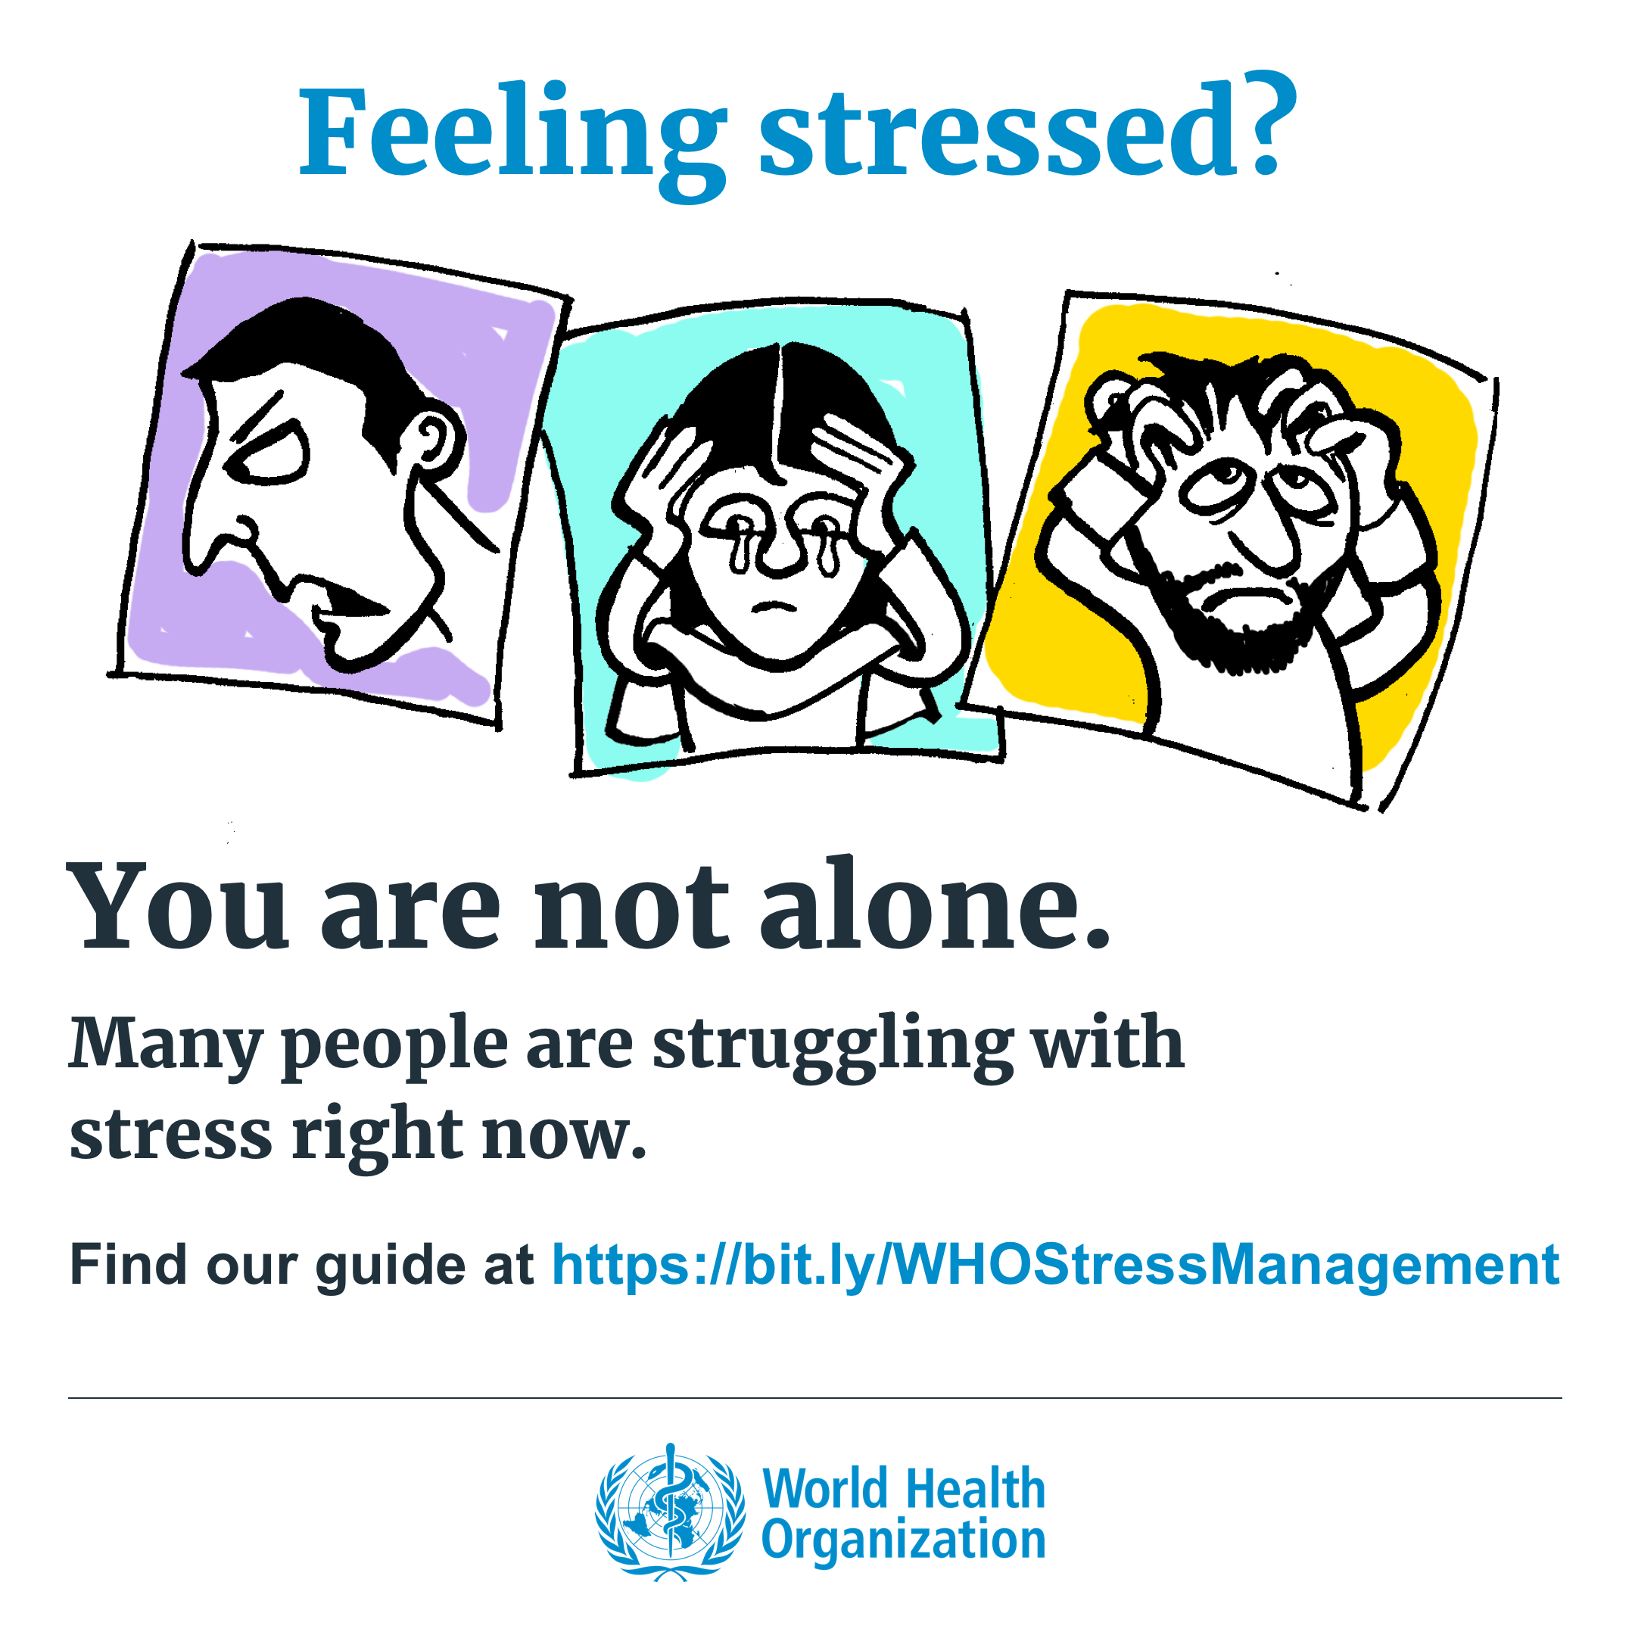
at https://www.who.int

Slide 4
Content
Health and Stress Definition
Physiological and Psychological Effects of Stress
Coping Mechanisms
Positive Effects of Stress
Conclusion

Slide 5
Sartorius (2006)

Slide 6
Stress
A person’s response to events that are threatening or challenging.
Stressors are very subjective.
E.g., birthdays, loss of a loved one
Acute stress vs. chronic stress
External | Internal
Deaths | Expectations
Injuries | Demands
Illnesses | Misperceptions
Relationship breakdown | Assumptions
Being a victim of crime | Fear
Retirement | Anger
Notes:
The word 'acute' means the symptoms develop quickly but do not last long. The events are usually very severe and an acute stress reaction typically occurs after an unexpected life crisis.

Slide 7
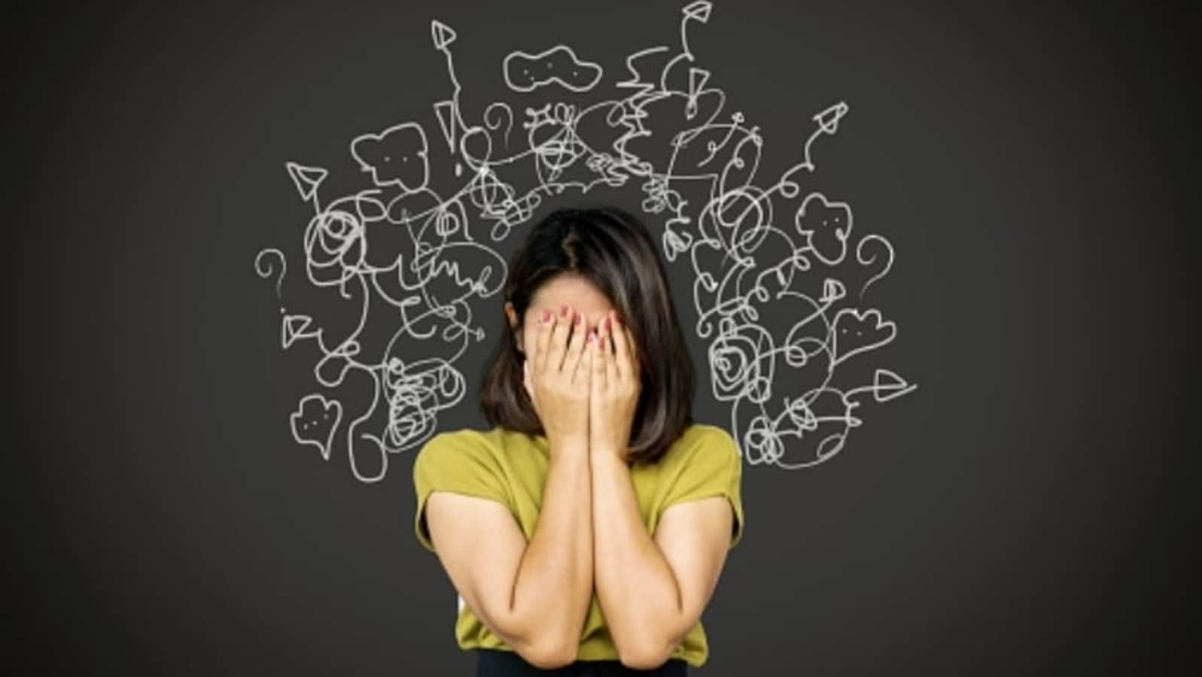
Chronic Stress
High cortisol levels can cause:
Brain size shrinking,
Lower volume in the prefrontal cortex,
Difficulty in processing emotions,
Difficulties in memory caused by less flexibility in hippocampus,
Negative thinking patterns including self-criticism, rumination, frequent worry, isolation,
Executive functioning problems including self-control, impulsivity, adaptation, planning,
Increase in depression, anxiety disorder or post-traumatic stress disorder (PTSD),
Insomnia.
Belleau et al., (2019), Liu et al., (2020), Tyng et al., (2017), Dioli et al., (2019), Stomby et al., (2016), Siddiqui et al., (2008)

Slide 8
Stages of Stress Reaction
General Adaptation Syndrome Model (GAS; Selye, 1950):
Alarm and Mobilisation
Resistance
Exhaustion***
***Unhealthy coping mechanisms can cause exhaustion.

Slide 9
Direct physiological effects
Elevated blood pressure
Decrease in immune system functioning
Increased hormonal activity
Psychophysiological conditions
Harmful behaviours
Increased smoking, alcohol use
Decreased nutrition
Decreased sleep
Increased drug use
Stress
Indirect health-related behaviours
Decreased compliance with medical advice
Increase in delays in seeking medical advice
Decrease in likelihood of seeking medical advice

Slide 10
Healthy Coping Mechanisms
1. Emotion-focused: People try to regulate their emotions to perceive the event as less stressful
E.g., Accepting sympathy from others and looking from the bright side after
loss of a loved one
2. Problem-focused: People try to solve their problems by producing new alternatives
E.g., Doing more sports to reduce work anxiety level
3. Increasing Emotional Resilience

Slide 11
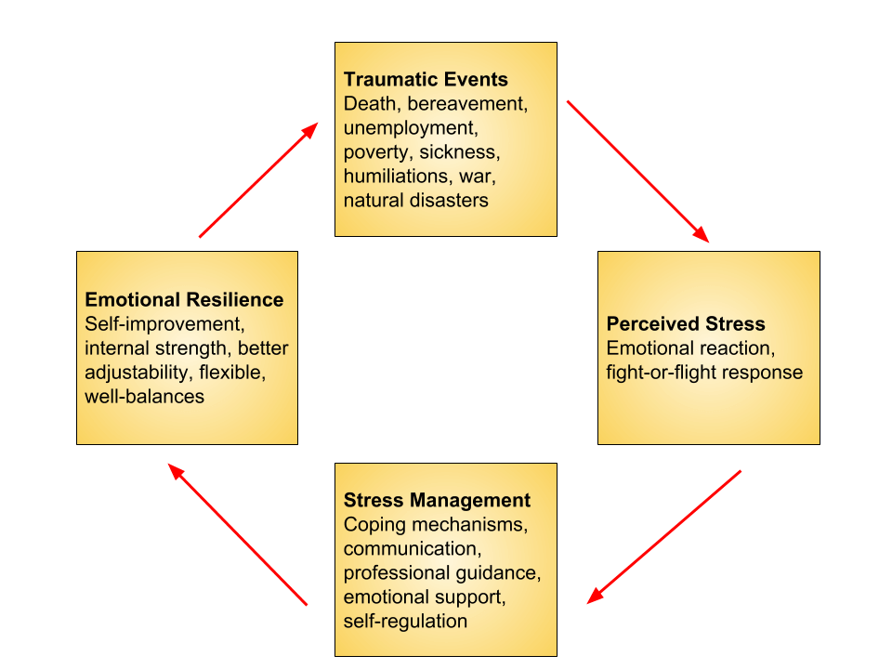
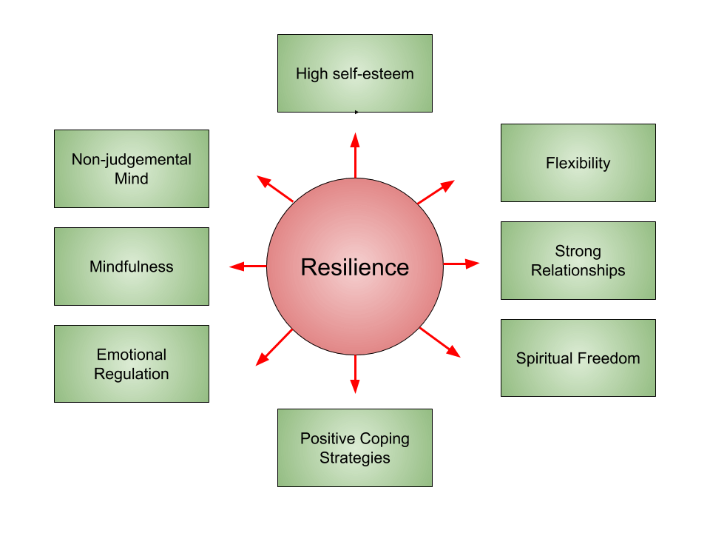
Emotional Resilience

Slide 12
Positive Effects of Stress
Activating fight-and-flight response,
Boosting brainpower,
Short-term stress can offer an immunity-based protection,
Increasing emotional resilience,
Increasing motivation to succeed.
Medline Plus, (2023), Yaribeygi et al., (2017), Dhabbar (2018)

Slide 13
Summary
Only chronic stress affects our health and wellbeing because we feel no longer in control.
If you have ongoing difficulties in managing stress, talk to a mental health professional.
This will help you to get the necessary psychological treatment you need (e.g., Eye Movement Desensitisation and Reprocessing, Schema Therapy, Cognitive Behavioural Therapy).
There will always be stressors. To cope with them, increasing emotional resilience and understanding the positive effects of stress are vital.

Slide 14
References
Sartorius N. (2006). The meanings of health and its promotion. Croatian Medical Journal, 47(4), 662–664.
Belleau, E. L., Treadway, M. T., & Pizzagalli, D. A. (2019). The Impact of Stress and Major Depressive Disorder on Hippocampal and Medial Prefrontal Cortex Morphology. Biological psychiatry, 85(6), 443–453. https://doi.org/10.1016/j.biopsych.2018.09.031
Liu, WZ., Zhang, WH., Zheng, ZH. et al. (2020). Identification of a prefrontal cortex-to-amygdala pathway for chronic stress-induced anxiety. Nat Commun 11, 22-21. https://doi.org/10.1038/s41467-020-15920-7
Sartorius N. (2006). The meanings of health and its promotion. Croatian Medical Journal, 47(4), 662–664.
Dhabhar F. S. (2018). The short-term stress response - Mother nature's mechanism for enhancing protection and performance under conditions of threat, challenge, and opportunity. Frontiers in Neuroendocrinology, 49, 175–192. https://doi.org/10.1016/j.yfrne.2018.03.004
Medline Plus (2023). https://medlineplus.gov/ency/article/003211.htm
Yaribeygi, H., Panahi, Y., Sahraei, H., Johnston, T. P., & Sahebkar, A. (2017). The impact of stress on body function: A review. EXCLI journal, 16, 1057–1072. https://doi.org/10.17179/excli2017-480
Siddiqui, S. V., Chatterjee, U., Kumar, D., Siddiqui, A., & Goyal, N. (2008). Neuropsychology of prefrontal cortex. Indian journal of psychiatry, 50(3), 202–208. https://doi.org/10.4103/0019-5545.43634
Tyng, C. M., Amin, H. U., Saad, M. N. M., & Malik, A. S. (2017). The Influences of Emotion on Learning and Memory. Frontiers in Psychology, 8, 1454. https://doi.org/10.3389/fpsyg.2017.01454
Dioli, C., Patrício, P., Sousa, N. et al. Chronic stress triggers divergent dendritic alterations in immature neurons of the adult hippocampus, depending on their ultimate t erminal fields. Transl Psychiatry 9, 143 (2019). https://doi.org/10.1038/s41398-019-0477-7
Stomby, A., Boraxbekk, C. J., Lundquist, A., Nordin, A., Nilsson, L. G., Adolfsson, R., Nyberg, L., & Olsson, T. (2016). Higher diurnal salivary cortisol levels are related to smaller prefrontal cortex surface area in elderly men and women. European journal of endocrinology, 175(2), 117–126. https://doi.org/10.1530/EJE-16-0352
Selye, H. (1950). Stress and the general adaptation syndrome. Br Med J., 4667), 1383-92.

Slide 15
Thank you
Özlem Burak​
ozlem.burak@emu.edu.tr

