Slide 1
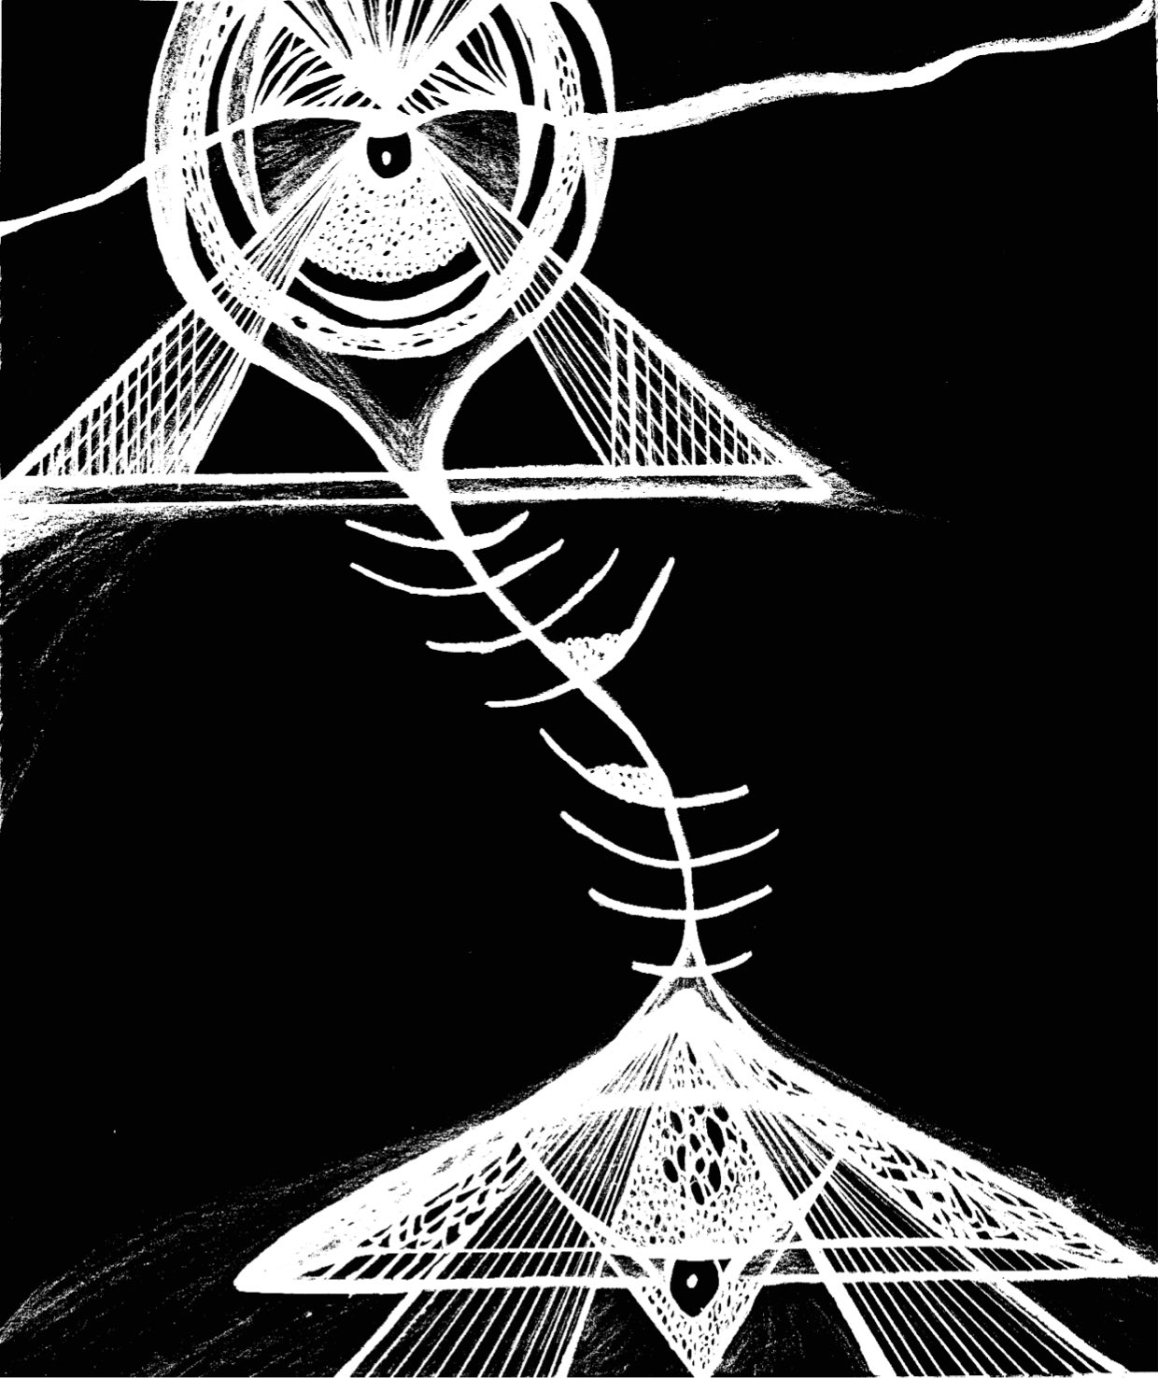
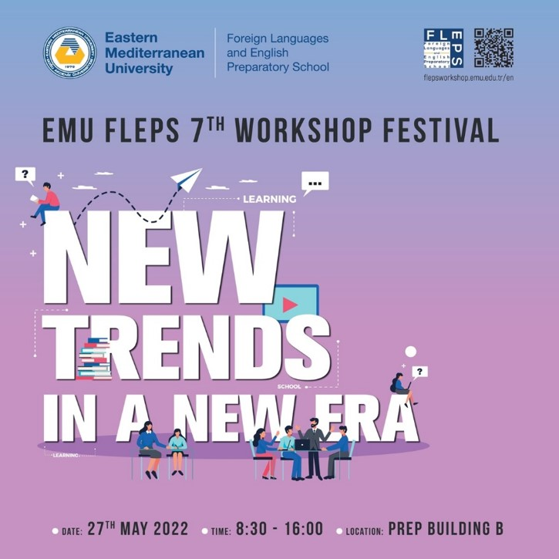
Creative Academia:
Re-writing
academic findings as poems
Nafia Akdeniz

Slide 2
Creative Academia
Nafia Akdeniz
Content
Personal story arch
Creative and academic sphere
Doctoral research findings
Writing and re-writing:
haiku & mandala
academic findings as haiku poems

Slide 3
Creative Academia
Nafia Akdeniz
Personal Story Arc
A book in progress…
Trees in Pots /
Roof Flowers /
Lost Doors /
Humanless Homes /
The First Carcass /
…
Communication &
Media Studies
PhD (2021)
English Literature &
Humanities
MA (2003-2006)
English Teaching
MA (2000-2003)
2nd poetry collection:
Yarım İnşaat /
Under Construction (2022)
English Literature & Humanities
BA (1995-99)
1st poetry collection:
Yok/Absence (2013)

Slide 4
Creative Academia
Nafia Akdeniz
Creative and Academic Sphere
Individual and Collective/Cultural Identity Construction and Circulation
Mediation
Production of
narratives via media:
Literature (poetry)
Films
Paintings
Objects
Monuments
Ruins
Rituals
History-writing
Projects
‘Imagined communities’
Constructed:
Families
Cities (Varosha)
Nations
Europe
World
Narrative Studies
Media Studies
Memory Studies
Heritage Studies
Communicating stories telling who we are and where we are going to.

Slide 5
Creative Academia
Research Questions and Findings
What do the Varoshians communicate with the narratives of place attachment?
How do these narratives function as an act/means of communication?

Slide 6
Creative Academia
Research Questions and Findings
What do the Varoshians communicate with the narratives of place attachment?
How do these narratives function as an act/means of communication?
NARRATIVE TYPOLOGY
Narrative of Loss
Narrative of Threshold
Narrative of the Future
Narrative of Transformation

Slide 7
Creative Academia
Research Questions and Findings
What do the Varoshians communicate with the narratives of place attachment?
How do these narratives function as an act/a means of communication?
NARRATIVE TYPOLOGY
NARRATIVE FUNCTIONALITY
mnemonic resistance
Narrative of Loss
Narrative of Threshold
Resistance to Oblivion
Resistance to Oppression
Narrative of the Future
Narrative of Transformation

Slide 8
Creative Academia
Research Questions and Findings
What do the Varoshians communicate with the narratives of place attachment?
How do these narratives function as an act/a means of communication?
Narrative of
Re-loss?
Have we lost the future?
Time to re-claim the future? How?
NARRATIVE FUNCTIONALITY
NARRATIVE TYPOLOGY
mnemonic resistance
Narrative of Loss
Narrative of Threshold
Resistance to Oblivion
Resistance to Oppression
Narrative of the Future
Narrative of Transformation

Slide 9
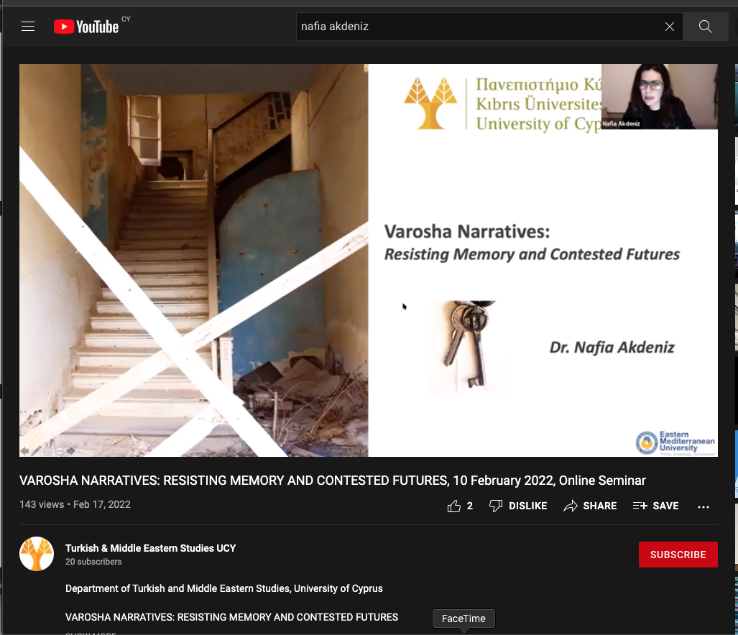
Creative Academia
Online seminar on YouTube:
Varosha Narratives:
Resisting Memory and Contested Futures
https://www.youtube.com/watch?v=1VlSIpWWae4

Slide 10
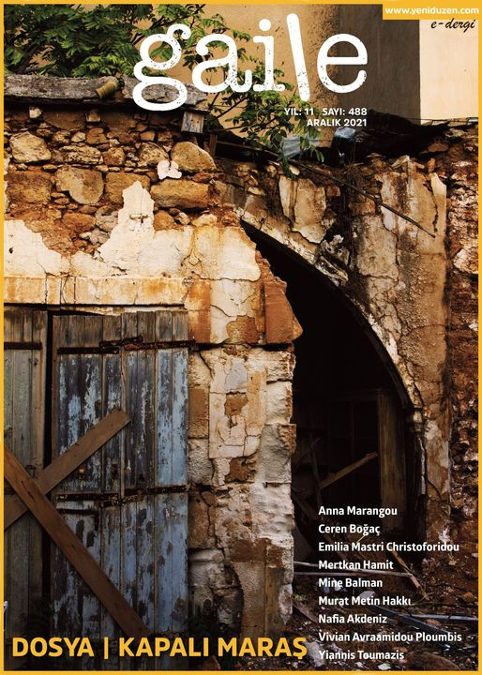
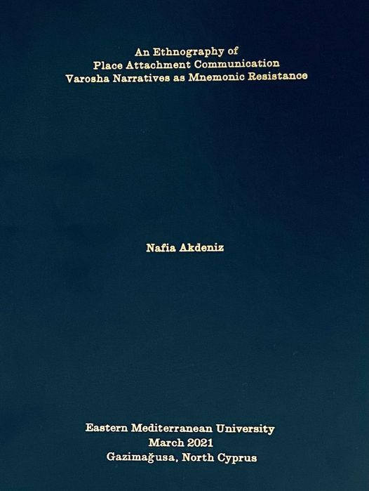
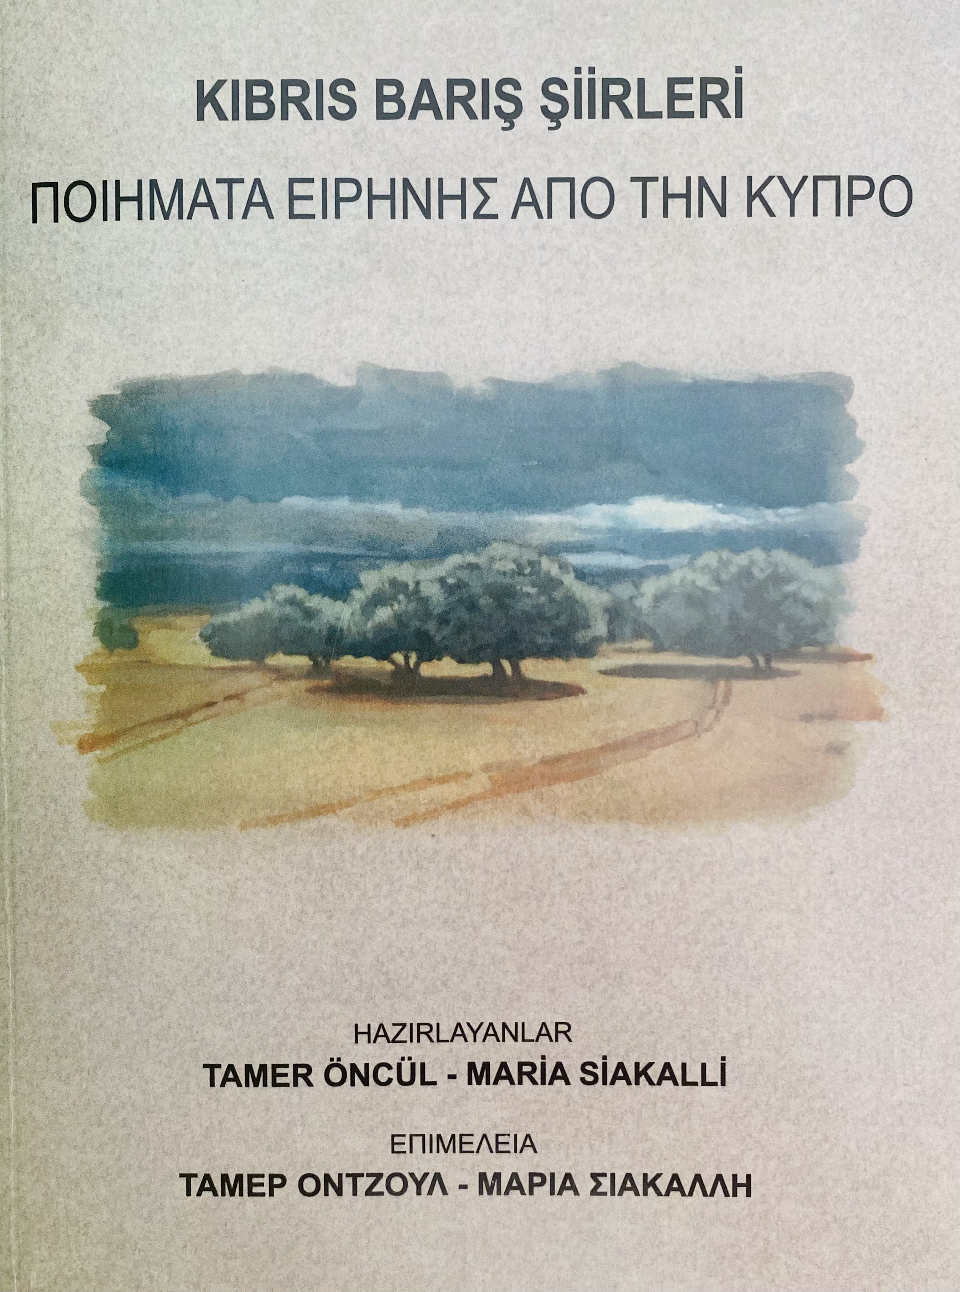
Creative Academia
Writing and Re-writing:
academic findings as poems
45
Inteview verbatim transcriptions & field observation notes
82
hours
an autoethnograpy
a book
seminars
conferences
articles
haiku poems
815
pages
http://hdl.handle.net/11129/5257
“no land’s human”
https://www.yeniduzen.com/no-lands-human-147966h.htm

Slide 11
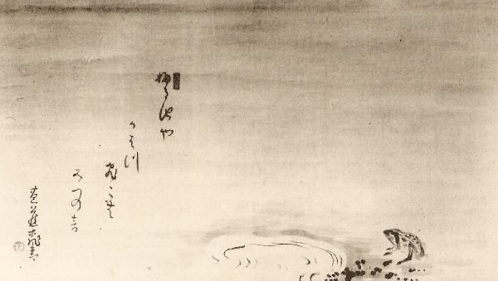
Creative Academia
HAIKU

Slide 12
Creative Academia
HAIKU
An old silent pond, A frog jumps into the pond, splash! Silence again.
Matsuo Bashō (1644 – 1694)

Slide 13
Creative Academia
HAIKU
An old silent pond, A frog jumps into the pond, splash! Silence again.
Matsuo Bashō (1644 – 1694)
originally Japanese form of poetry
3 lines: 5-7-5 syllables (17)
close observation of nature / of human nature / of human culture (?)
reference to season / seasonal clues / to time (?)
strong image: a moment of realization, awareness, awakening, (in)sight
juxtaposition of two images.

Slide 14
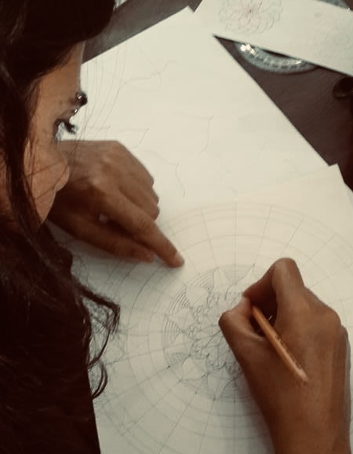
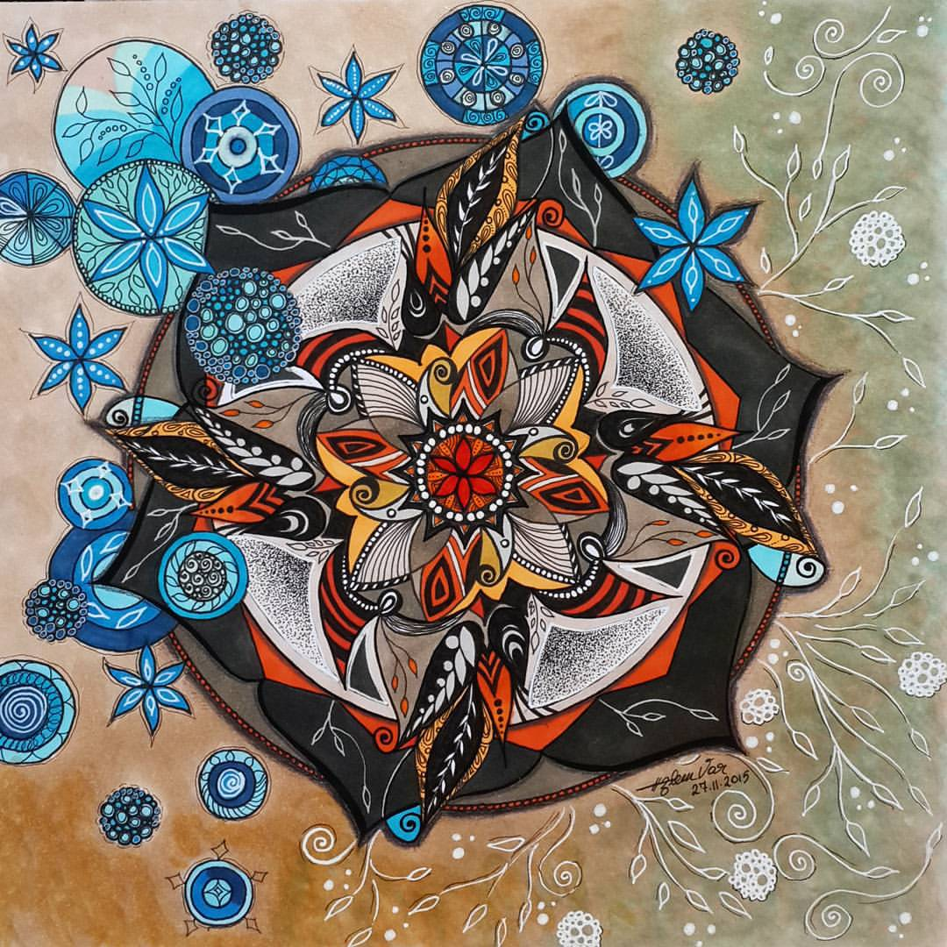
Creative Academia
MANDALA: circle, center
an aid to meditation, a spiritual guidance and journey, a tool for establishing a sacred place…
Özlem Var
Represents…
the cycles of birth-life-death
the interconnectedness of all living things
realization of the self as one with the divine

Slide 15
Creative Academia
MANDALA: circle, center
an aid to meditation, a spiritual guidance and journey, a tool for establishing a sacred place…
can be carefully measured, geometric, and symmetrical, OR in contrast; asymmetrical, organic, and free flowing…
Özlem Var
Represents…
the cycles of birth-life-death
the interconnectedness of all living things
realization of the self as one with the divine

Slide 16
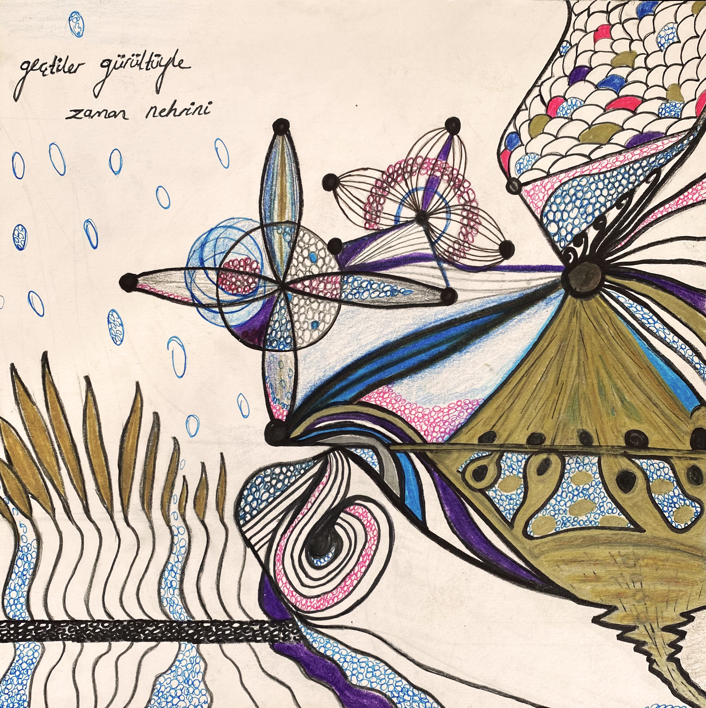
Creative Academia
MANDALA: circle, center
an aid to meditation, a spiritual guidance and journey, a tool for establishing a sacred place…
can be carefully measured, geometric, and symmetrical, OR in contrast, asymmetrical, organic, and free flowing…
Özlem Var
Represents…
the cycles of birth-life-death
the interconnectedness of all living things
realization of the self as one with the divine

Slide 17
Creative Academia
Nafia Akdeniz
A book in progress… title?
Trees in Pots
Humanless Homes
Roof Flowers
The First Carcass
Lost Doors

Slide 18
Creative Academia
Nafia Akdeniz
Trees in pots...
“My mother died in 2014 and she loved flowers, trees, she adored them and she was always planting in pots... Every time I asked her ‘why don’t you plant in the ground mum?’ she said ‘when I go back home in Famagusta, I will take them with me and plant to root into ground there’...”

Slide 19
Creative Academia
Nafia Akdeniz
saksıya eker
evinden edilenler
ağaçlarını
planted in pots
of displaced people
the trees.
Trees in pots...
“My mother died in 2014 and she loved flowers, trees, she adored them and she was always planting in pots... Every time I asked her ‘why don’t you plant in the ground mum?’ she said ‘when I go back home in Famagusta, I will take them with me and plant to root into ground there’...”

Slide 20
Creative Academia
Nafia Akdeniz
-- You see that column, it’s bending, and it is so much weight on top gathered all these years
-- Yes, I also see the wild flowers blossoming over the roof…
-- Becase of the dust, the leaves, and everything, all stay on top and gets heavier and heaver… The house cannot carry it anymore and collapses…
Roof flowers...

Slide 21
Creative Academia
Nafia Akdeniz
-- You see that column, it’s bending, and it is so much weight on top gathered all these years
-- Yes, I also see the wild flowers blossoming over the roof…
-- Becase of the dust, the leaves, and everything, all stay on top and gets heavier and heaver… The house cannot carry it anymore and collapses…
Roof flowers...
biriken tozdur
çatı çiçeklerinin
bitek toprağı
dust amassed
is of the roof flowers
fertile soil.

Slide 22
Creative Academia
Nafia Akdeniz
Lost doors...
”Famagusta will always carry the full weight of the return, the whole burden of the reunification of our homeland. There is no longer a vision in this place. So what's left for us? A key, a key that locked the doors once and secured the house - as if it was needed, will now unlock memories that will gently take us back in time… So stand high all together, since it is our duty to stay alive and together to return. Send us your own Varoshian stories, messages... We are not afraid of storms anymore.”

Slide 23
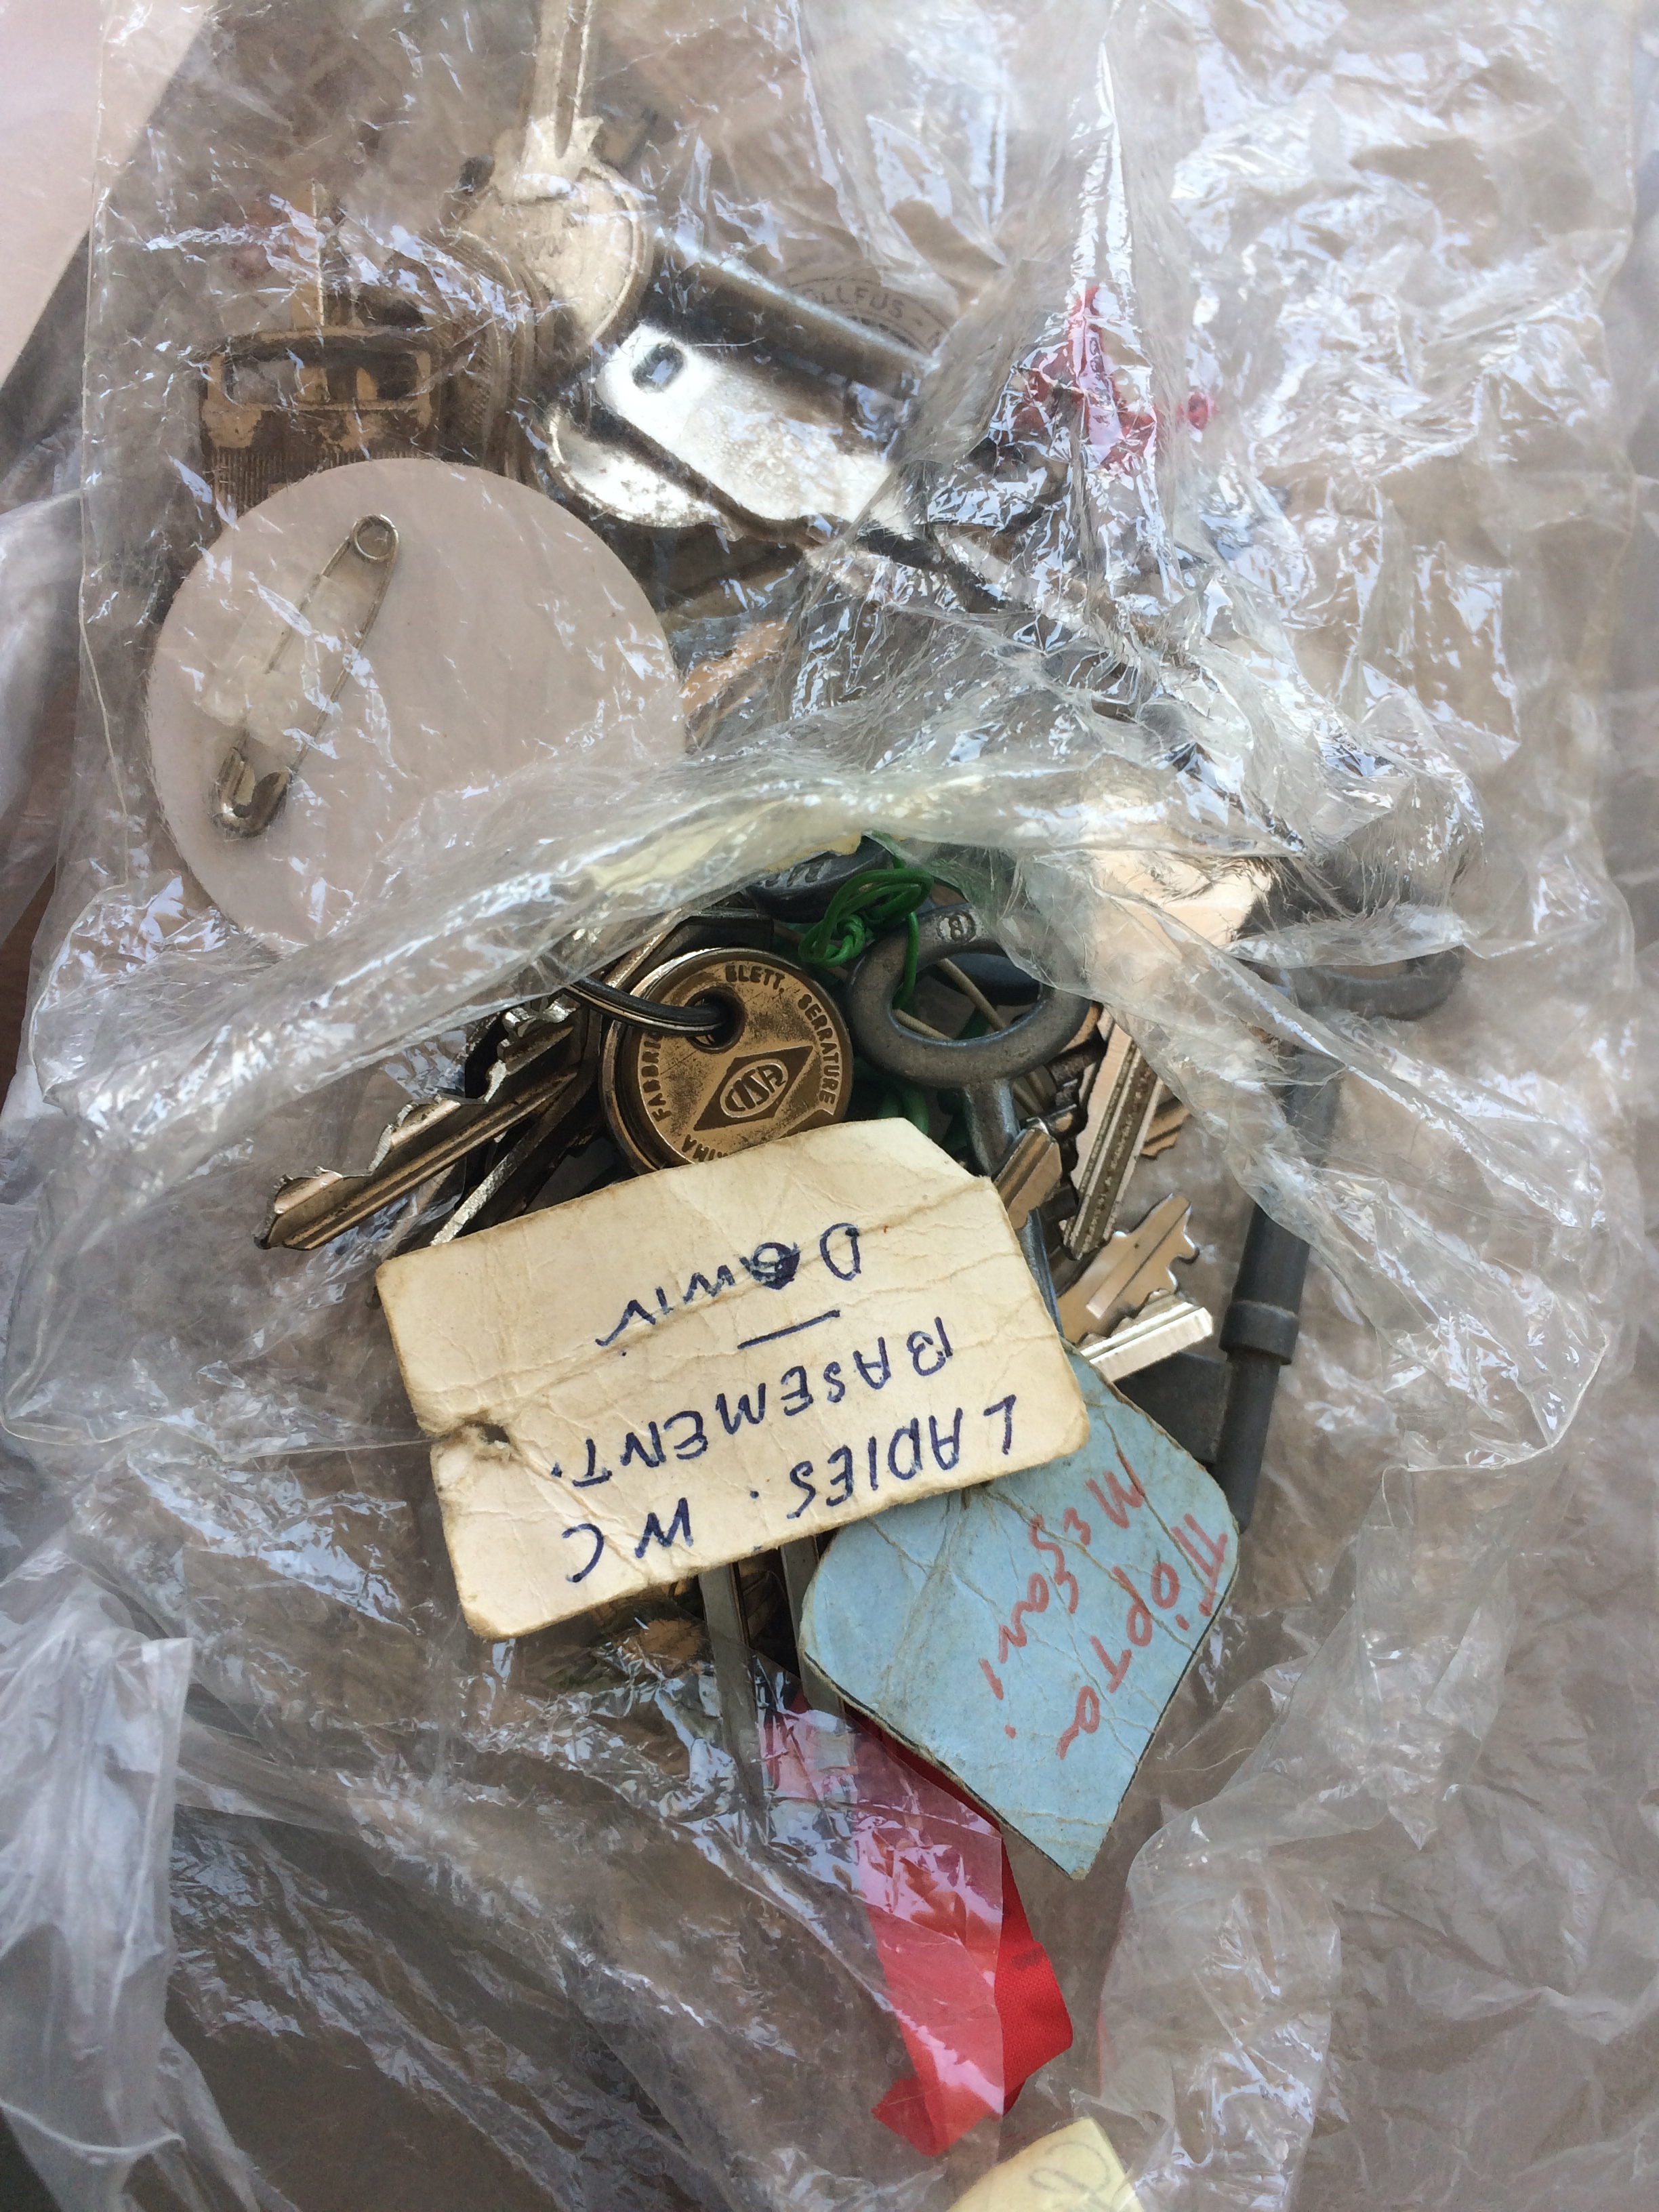
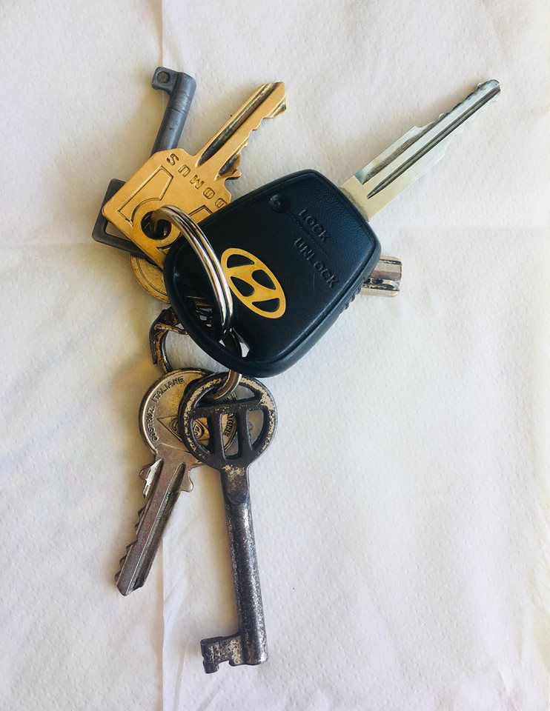
Creative Academia
Nafia Akdeniz
Lost doors...
”Famagusta will always carry the full weight of the return, the whole burden of the reunification of our homeland. There is no longer a vision in this place. So what's left for us? A key, a key that locked the doors once and secured the house - as if it was needed, will now unlock memories that will gently take us back in time… So stand high all together, since it is our duty to stay alive and together to return. Send us your own Varoshian stories, messages... We are not afraid of storms anymore.”

Slide 24
Creative Academia
Nafia Akdeniz
kayıp kapılar —
bellek kilidi açar
elde anahtar.
the lost doors —
unlocks the memory
in hand the key.
Lost doors...
”Famagusta will always carry the full weight of the return, the whole burden of the reunification of our homeland. There is no longer a vision in this place. So what's left for us? A key, a key that locked the doors once and secured the house - as if it was needed, will now unlock memories that will gently take us back in time… So stand high all together, since it is our duty to stay alive and together to return. Send us your own Varoshian stories, messages... We are not afraid of storms anymore.”

Slide 25
Creative Academia
Nafia Akdeniz
Humanless homes…
… my eyes hurt a lot when it’s windy... I lost my lushes after chemotherapy and nothing protects my eyes from the wind or from the dust or from anything in the air…

Slide 26
Creative Academia
Nafia Akdeniz
Humanless homes…
kirpiksiz gözün
rüzgârdan çektiğidir
insansız ev.
an eye lost lash
suffers the wind the same
a humanless home.
… my eyes hurt a lot when it’s windy... I lost my lushes after chemotherapy and nothing protects my eyes from the wind or from the dust or from anything in the air…

Slide 27
Creative Academia
Nafia Akdeniz

Slide 28
Creative Academia
Nafia Akdeniz
kafası çatım
kuyruğu ağaç köküm
balık, ilk karkas —
its head my roof
its tail my tree root
fish, the first carcass —

Slide 29
Creative Academia
Nafia Akdeniz
Thank you…

